Slide 1
CSE417T – Lecture 22
Please mute yourself and turn off videos to save bandwidth.
If you have questions during the lecture
Use chatrooms to post your questions
I’ll review chatrooms in batches
You can also un-mute yourself and ask the questions directly
The slides are posted on the course website
RECORD THE LECTURE!
Please remind me if I forget to do so.

Slide 2
Logistics: Homework and Exam 2
Homework 4 was due yesterday.
Up to 3 late days can be used if you still have late days left
Homework 5 will be due on April 19 (Sunday), 11:30AM
At most two late days can be used in this homework
I’ll post the submission link on Friday to avoid conflicts with HW4 submissions.
Exam 2 will be online on Canvas on April 23 (Thursday).
See Slides on April 7 for more details

Slide 3
Logistics: Exam 2
Exam 2 will be online on Canvas on April 23 (Thursday).
Dummy practice exam
Will post a practice exam with dummy questions later this week
The goal is for both you and me to get familiar with the process
Canvas quiz
Lockdown browser
Remaining lectures
Apr 14 (Tue): Learning in Neural Networks
Apr 16 (Thu): Discussion on Neural Networks
Apr 21 (Tue): Brief review and office hour
Apr 23 (Thu): Exam 2

Slide 4
Recap

Slide 5
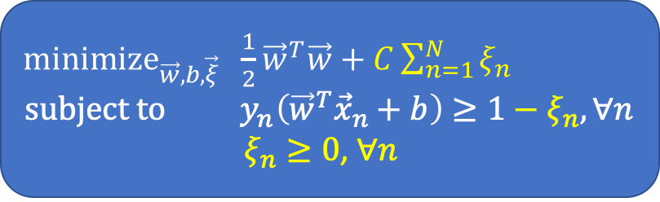
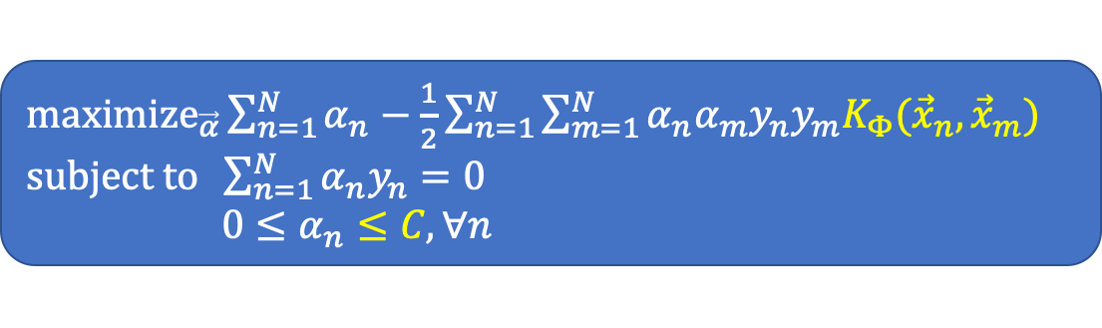
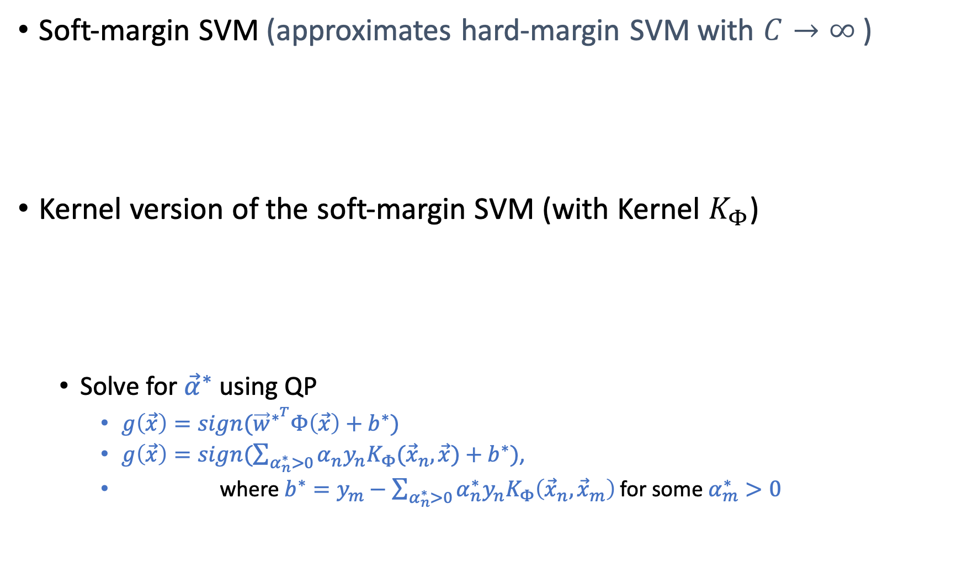
Support Vector Machines
Soft-margin SVM (approximates hard-margin SVM with $C→∞$)
Kernel version of the soft-margin SVM (with Kernel $K_{Φ}$)
Solve for ${\vec{α}}^{∗}$ using QP
$g\left(\vec{x}\right)=sign({\vec{w}}^{∗^{T}}Φ\left(\vec{x}\right)+b^{∗})$
$g\left(\vec{x}\right)=sign(\sum_{α_{n}^{∗}>0}{α_{n}y_{n}K_{Φ}({\vec{x}}_{n},\vec{x})}+b^{∗})$,
where $b^{∗}=y_{m}−\sum_{α_{n}^{∗}>0}{α_{n}^{∗}y_{n}K_{Φ}\left({\vec{x}}_{n},{\vec{x}}_{m}\right)}$ for some $α_{m}^{∗}>0$
${\text{minimize}}_{\vec{w},b,\vec{ξ}} \frac{1}{2}{\vec{w}}^{T}\vec{w}+C\sum_{n=1}^{N}{ξ_{n}}$ $$\text{subject} \text{to} y_{n}\left({\vec{w}}^{T}{\vec{x}}_{n}+b\right)≥1−ξ_{n}, ∀n$$
$ξ_{n}≥0$, $∀n$
${\text{maximize}}_{\vec{α}}\sum_{n=1}^{N}{α_{n}}−\frac{1}{2}\sum_{n=1}^{N}{\sum_{m=1}^{N}{α_{n}α_{m}y_{n}y_{m}K_{Φ}({\vec{x}}_{n},{\vec{x}}_{m})}}$ $\text{subject} \text{to} \sum_{n=1}^{N}{α_{n}y_{n}=0}$ $0≤α_{n}≤C,∀n$

Slide 6
Neural Networks

Slide 7
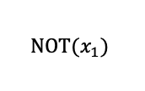
Implementing Logic Gates with Perceptron
0
-1
$$\text{NOT}(x_{1})$$
Impossible to implement XOR using a single perceptron

Slide 8
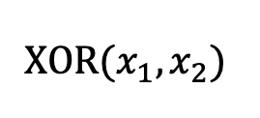
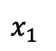
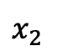
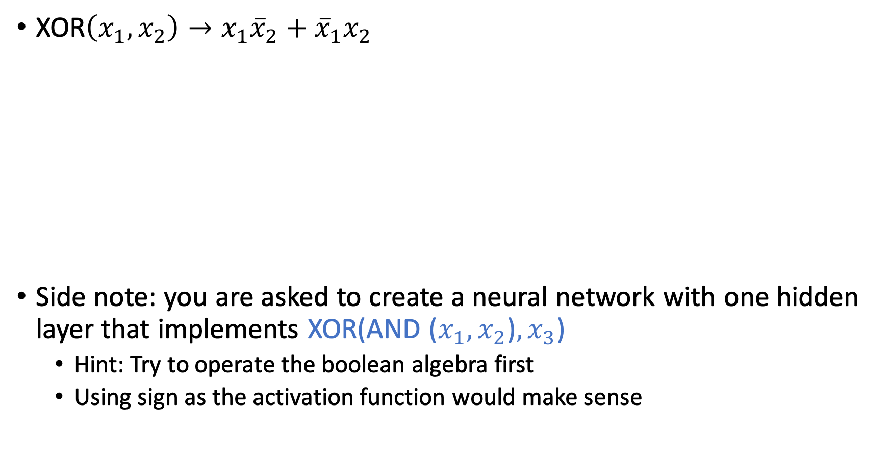
Multi-Layer Perceptron
XOR$\left(x_{1},x_{2}\right)→x_{1}{\overline{x}}_{2}+{\overline{x}}_{1}x_{2}$
Side note: you are asked to create a neural network with one hidden layer that implements XOR(AND ($x_{1},x_{2}$)$,x_{3}$)
Hint: Try to operate the boolean algebra first
Using sign as the activation function would make sense
$$\text{XOR}(x_{1},x_{2})$$
$$x_{1}$$
$$x_{2}$$

Slide 9
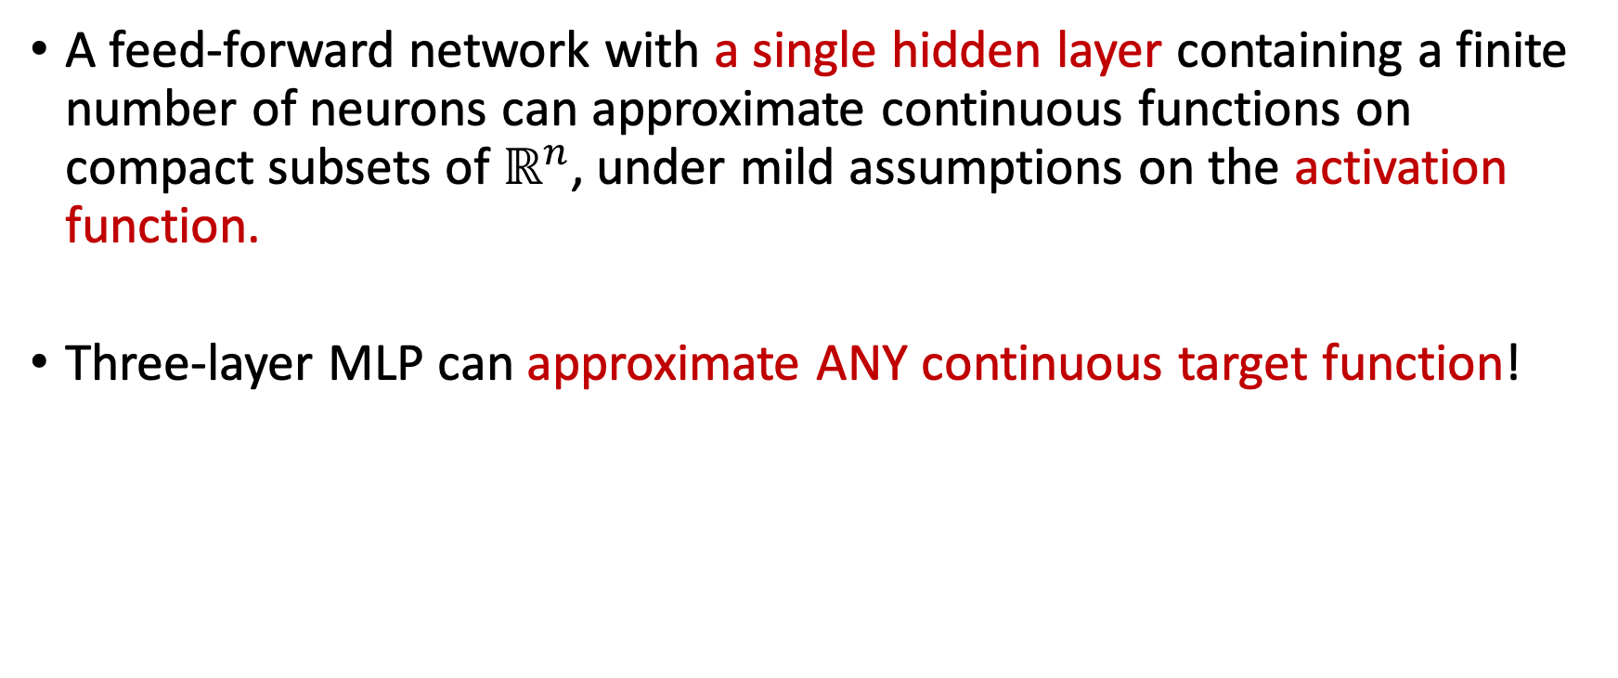
Universal approximation theorem
A feed-forward network with a single hidden layer containing a finite number of neurons can approximate continuous functions on compact subsets of$ℝ^{n}$, under mild assumptions on the activation function.
Three-layer MLP can approximate ANY continuous target function!
Notes:
Activation function – non-constant, bounded, continuous

Slide 10
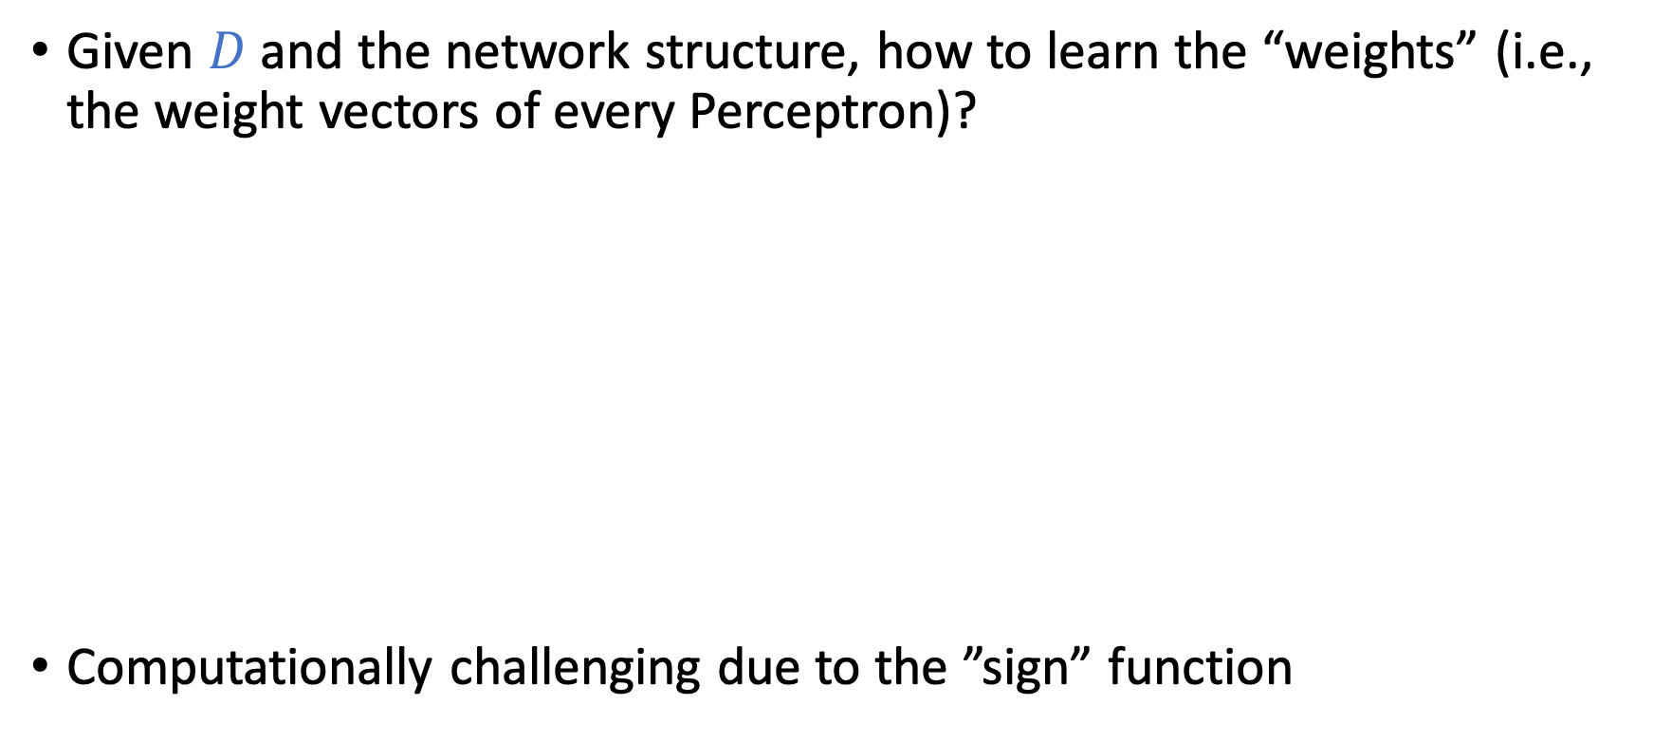
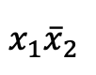
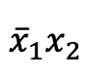
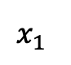
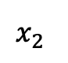
How to Learn MLP From Data?
Given $D$ and the network structure, how to learn the “weights” (i.e., the weight vectors of every Perceptron)?
Computationally challenging due to the ”sign” function
$$x_{1}$$
$$x_{1}{\overline{x}}_{2}$$
$$x_{2}$$
$${\overline{x}}_{1}x_{2}$$

Slide 11
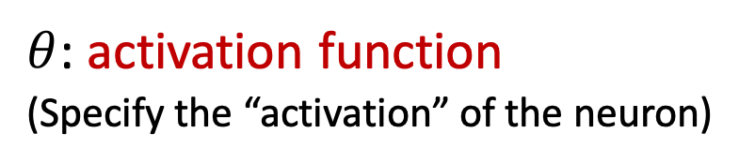
Neural Networks
A softened version of multi-layer Perceptron (MLP)
$θ$: activation function
(Specify the “activation” of the neuron)

Slide 12
Lecture Notes Today
The notes are not intended to be comprehensive. They should be accompanied by lectures and/or textbook.
Let me know if you spot errors.
Notes:
This is the lecture I wish I have 6 chalkboards to utilize

Slide 13
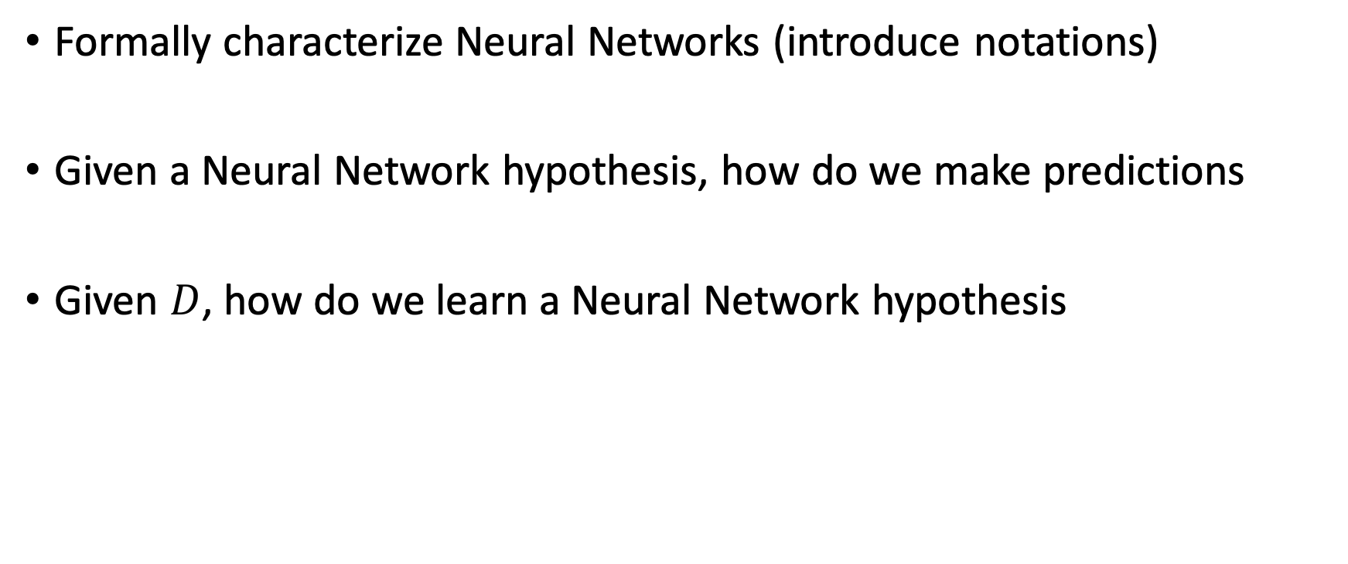
Goal of Today
Formally characterize Neural Networks (introduce notations)
Given a Neural Network hypothesis, how do we make predictions
Given $D$, how do we learn a Neural Network hypothesis

Slide 14
Notations of Neural Networks (NN)

Slide 15
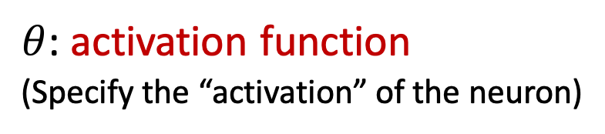
Neural Networks
$θ$: activation function
(Specify the “activation” of the neuron)

Slide 16
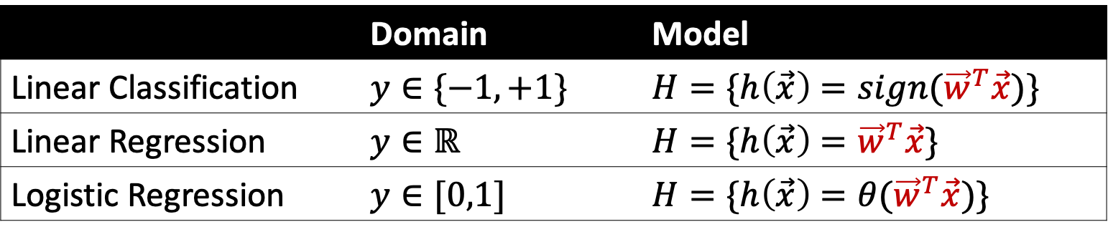
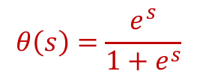
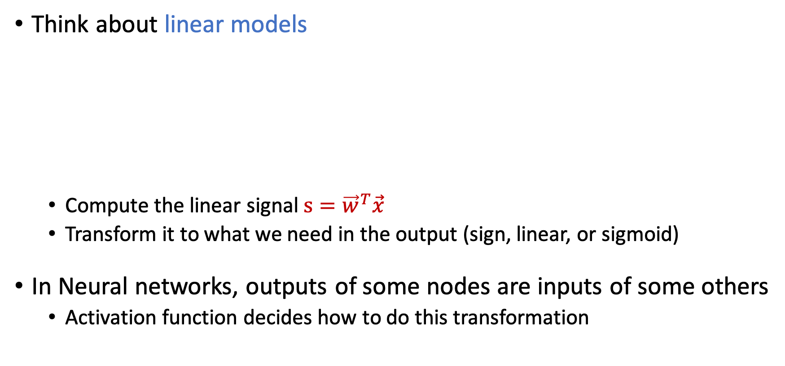
Activation Function
Think about linear models
Compute the linear signal $s={\vec{w}}^{T}\vec{x}$
Transform it to what we need in the output (sign, linear, or sigmoid)
In Neural networks, outputs of some nodes are inputs of some others
Activation function decides how to do this transformation
 | Domain | Model
Linear Classification | $$y∈\{−1,+1\}$$ | $$H=\{h\left(\vec{x}\right)={sign(\vec{w}}^{T}\vec{x})\}$$
Linear Regression | $$y∈ℝ$$ | $$H=\{h\left(\vec{x}\right)={\vec{w}}^{T}\vec{x}\}$$
Logistic Regression | $$y∈[0,1]$$ | $$H=\{h\left(\vec{x}\right)={θ(\vec{w}}^{T}\vec{x})\}$$
$$θ\left(s\right)=\frac{e^{s}}{1+e^{s}}$$

Slide 17
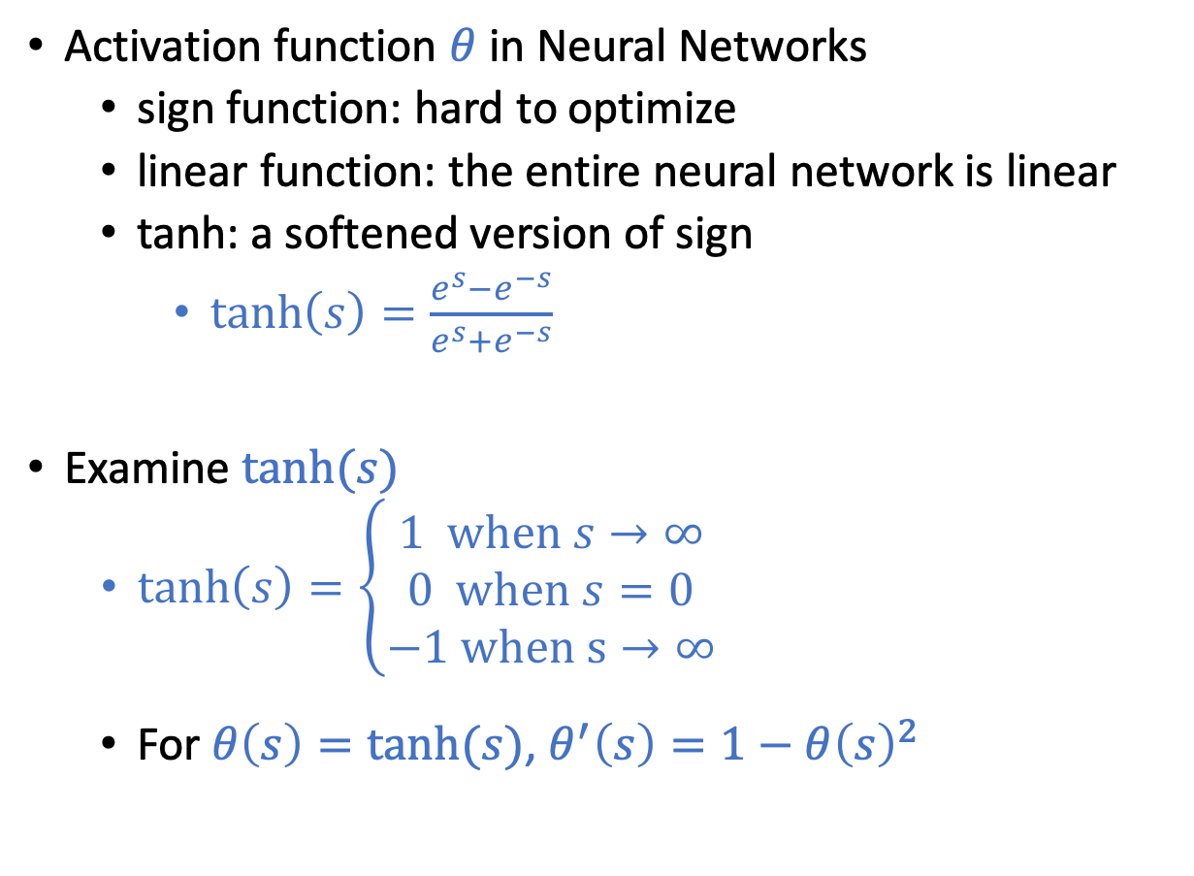

Activation Function
Activation function $θ$ in Neural Networks
sign function: hard to optimize
linear function: the entire neural network is linear
tanh: a softened version of sign
$\tanh\left(s\right)=\frac{e^{s}−e^{−s}}{e^{s}+e^{−s}}$
Examine $\tanh{(s)}$
$\tanh\left(s\right)=\left\{\begin{aligned}1 \text{when} s→∞ \\ 0 \text{when} s=0 \\ −1 \text{when} \text{s}→∞\end{aligned}\right.$
For $θ\left(s\right)=tanh⁡(s)$, $θ^{′}\left(s\right)=1−θ{\left(s\right)}^{2}$
$$θ$$

Slide 18
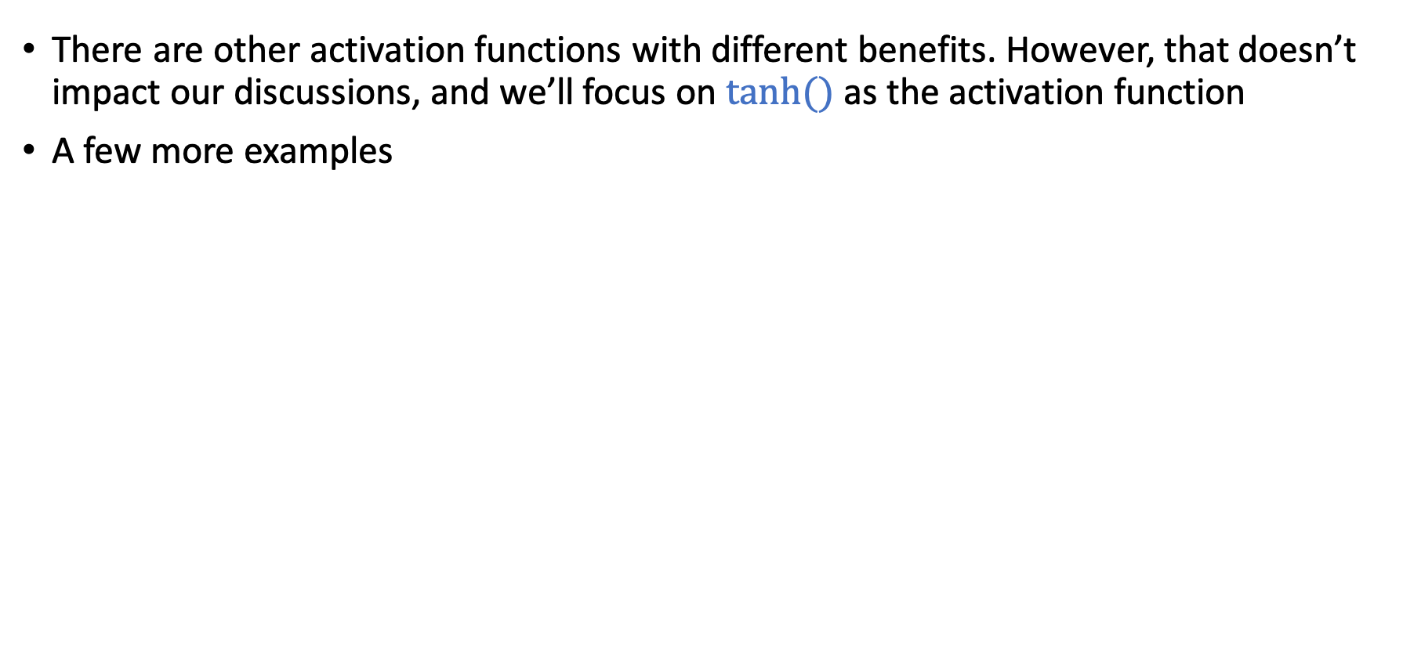
Activation Function
There are other activation functions with different benefits. However, that doesn’t impact our discussions, and we’ll focus on $tanh⁡()$ as the activation function
A few more examples
https://towardsdatascience.com/activation-functions-neural-networks-1cbd9f8d91d6

Slide 19
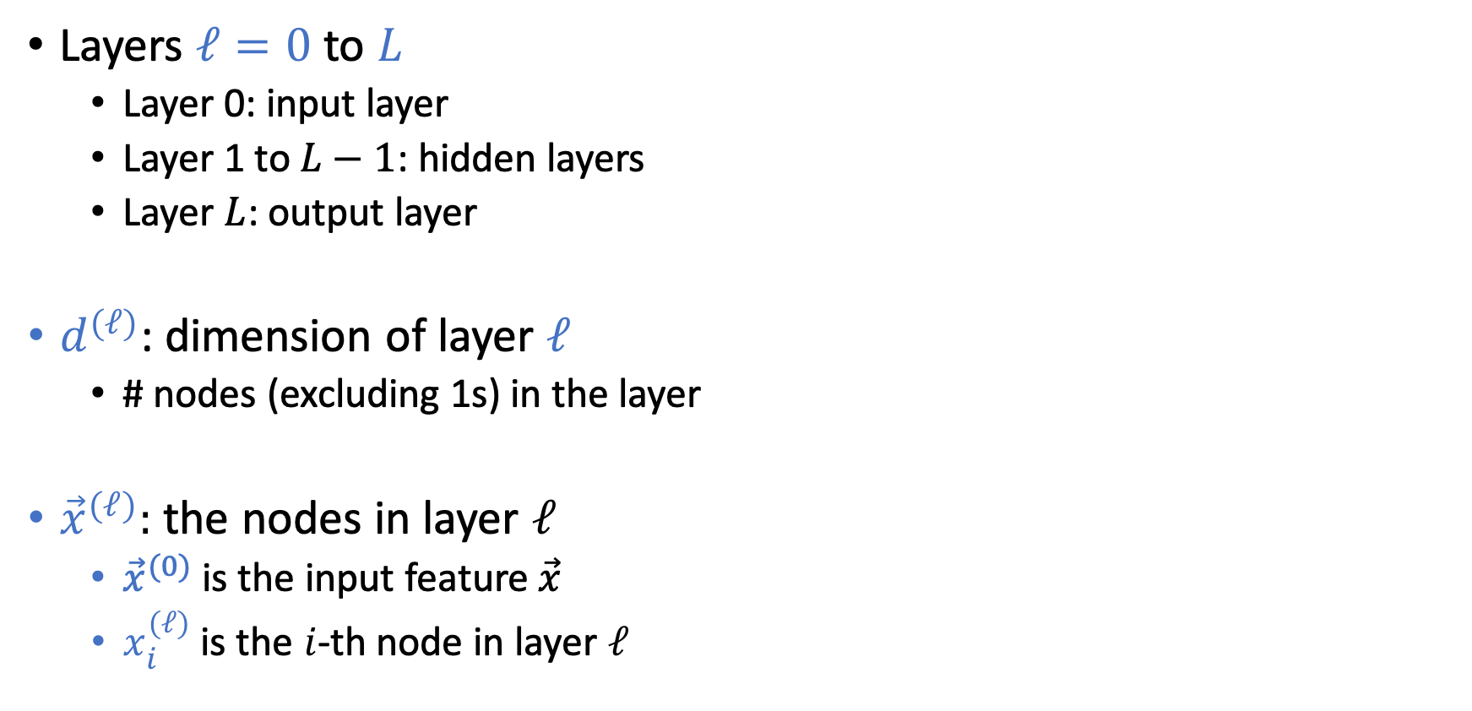
Notations of Neural Networks
Layers $ℓ=0$ to $L$
Layer 0: input layer
Layer 1 to $L−1$: hidden layers
Layer $L$: output layer
$d^{(ℓ)}$: dimension of layer $ℓ$
# nodes (excluding 1s) in the layer
${\vec{x}}^{(ℓ)}:$ the nodes in layer $ℓ$
${\vec{x}}^{(0)}$ is the input feature $\vec{x}$
$x_{i}^{(ℓ)}$ is the $i$-th node in layer $ℓ$

Slide 20
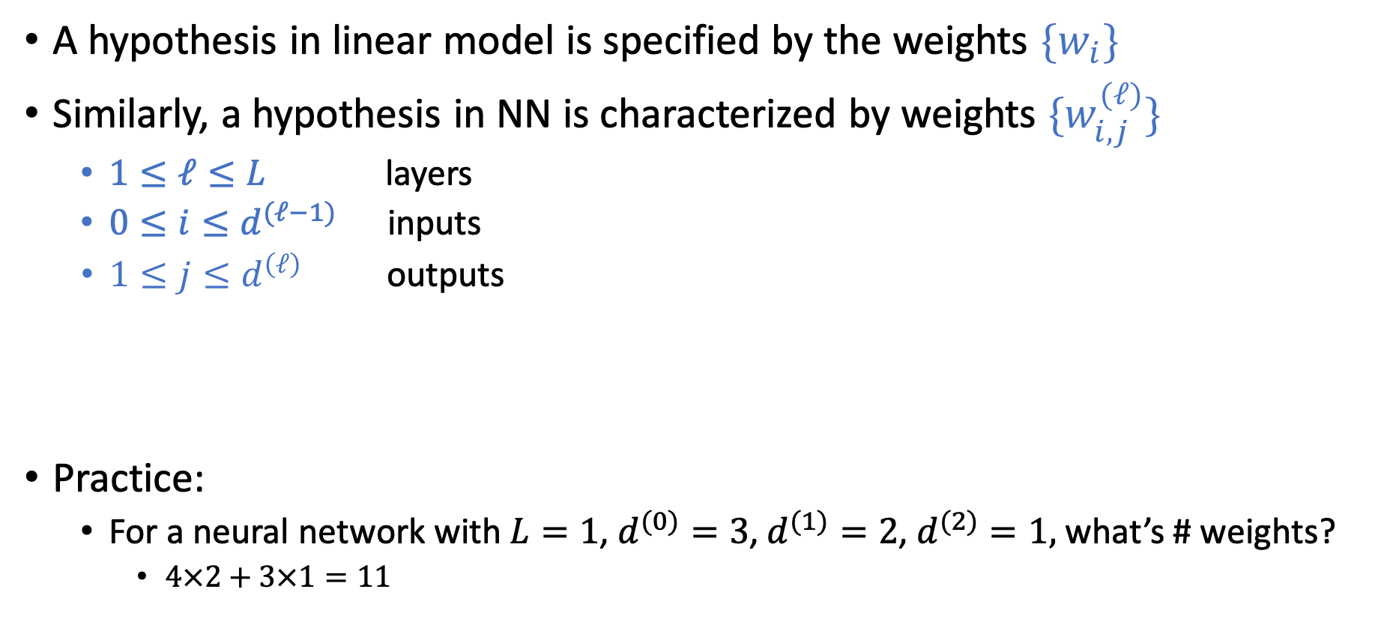
Notations of Neural Networks (NN)
A hypothesis in linear model is specified by the weights $\{w_{i}\}$
Similarly, a hypothesis in NN is characterized by weights ${\{w}_{i,j}^{(ℓ)}\}$
$1≤ℓ≤L$ layers
$0≤i≤d^{(ℓ−1)}$ inputs
$1≤j≤d^{\left(ℓ\right)}$ outputs
Practice:
For a neural network with $L=1$, $d^{(0)}=3$, $d^{(1)}=2$, $d^{(2)}=1,$ what’s # weights?
$4×2+3×1=11$
Notes:
4x2 + 3x1 = 11

Slide 21
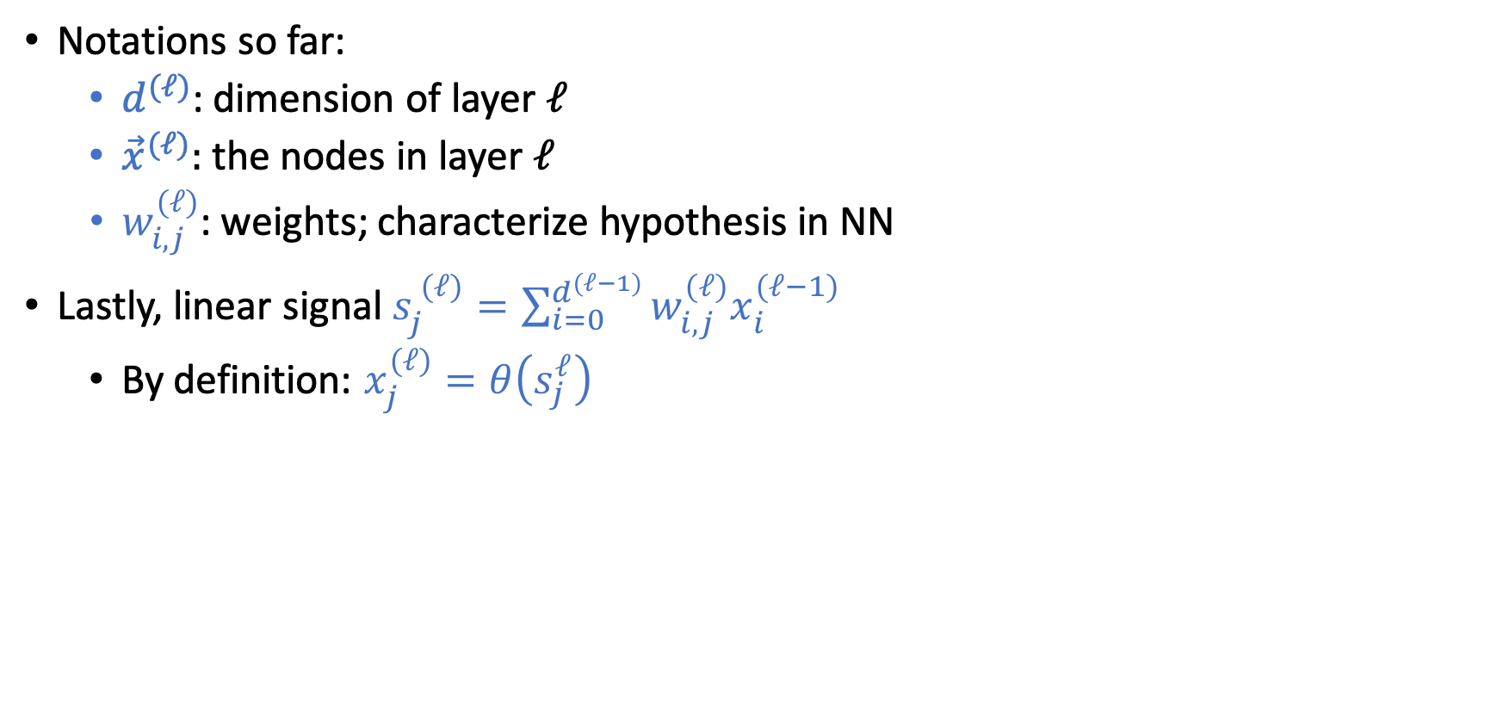
Notations of Neural Networks (NN)
Notations so far:
$d^{(ℓ)}$: dimension of layer $ℓ$
${\vec{x}}^{(ℓ)}:$ the nodes in layer $ℓ$
$w_{i,j}^{(ℓ)}$: weights; characterize hypothesis in NN
Lastly, linear signal $s_{j}^{ (ℓ)}=\sum_{i=0}^{d^{(ℓ−1)}}{w_{i,j}^{(ℓ)}x_{i}^{(ℓ−1)}}$
By definition: $x_{j}^{(ℓ)}=θ\left(s_{j}^{ℓ}\right)$
Notes:
4x2 + 3x1 = 11

Slide 22

Forward Propagation
Backpropagation
Given a NN hypothesis and a point $\vec{x}$, how do we make predictions
Learn a Neural Network hypothesis from data

Slide 23
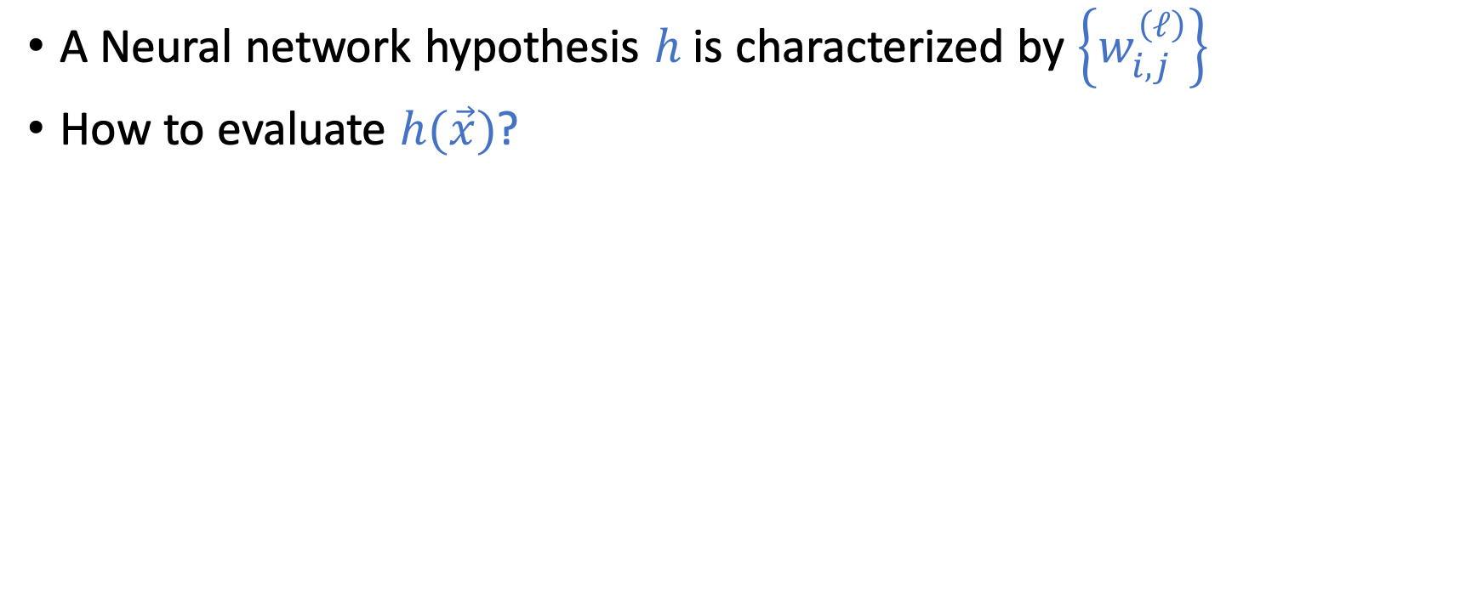
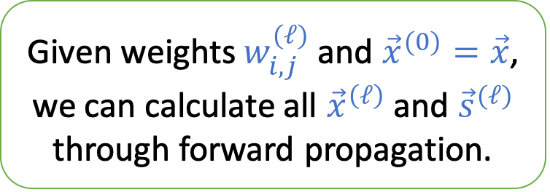
Forward Propagation
A Neural network hypothesis $h$ is characterized by $\left\{w_{i,j}^{\left(ℓ\right)}\right\}$
How to evaluate $h(\vec{x})$?
Given weights $w_{i,j}^{(ℓ)}$ and ${\vec{x}}^{(0)}=\vec{x}$, we can calculate all ${\vec{x}}^{\left(ℓ\right)}$ and ${\vec{s}}^{(ℓ)}$ through forward propagation.

Slide 24
Short Break and Q&A

Slide 25
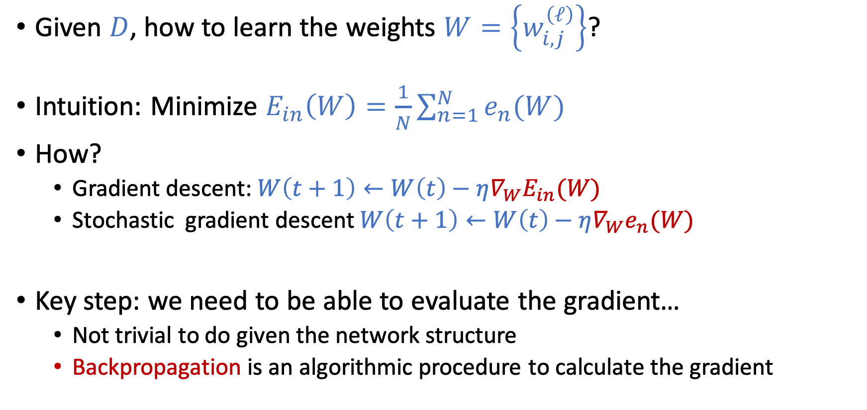
How to Learn NN From Data?
Given $D$, how to learn the weights $W=\left\{w_{i,j}^{\left(ℓ\right)}\right\}$?
Intuition: Minimize $E_{in}\left(W\right)=\frac{1}{N}\sum_{n=1}^{N}{e_{n}(W)}$
How?
Gradient descent: $W\left(t+1\right)←W\left(t\right)−η∇_{W}E_{in}(W)$
Stochastic gradient descent $W\left(t+1\right)←W\left(t\right)−η∇_{W}e_{n}(W)$
Key step: we need to be able to evaluate the gradient…
Not trivial to do given the network structure
Backpropagation is an algorithmic procedure to calculate the gradient

Slide 26
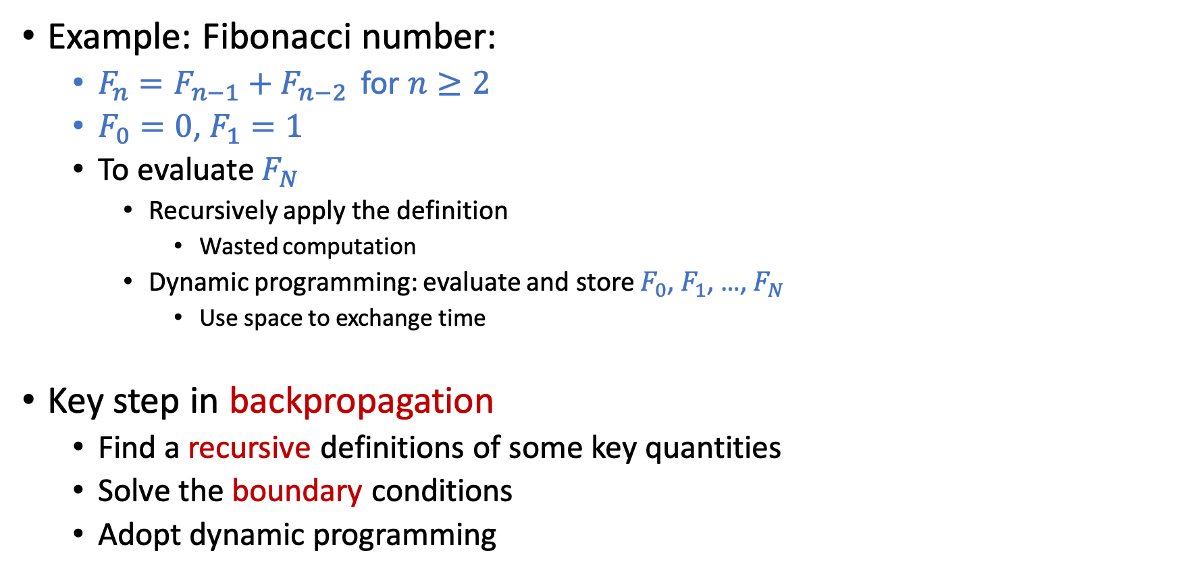
Quick Review on Dynamic Programming
Example: Fibonacci number:
$F_{n}=F_{n−1}+F_{n−2 }$ for $n≥2$
$F_{0}=0$, $F_{1}=1$
To evaluate $F_{N}$
Recursively apply the definition
Wasted computation
Dynamic programming: evaluate and store $F_{0}$, $F_{1}$, …, $F_{N}$
Use space to exchange time
Key step in backpropagation
Find a recursive definitions of some key quantities
Solve the boundary conditions
Adopt dynamic programming

Slide 27
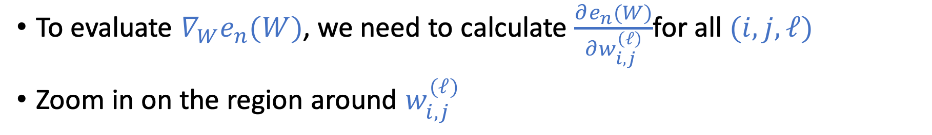
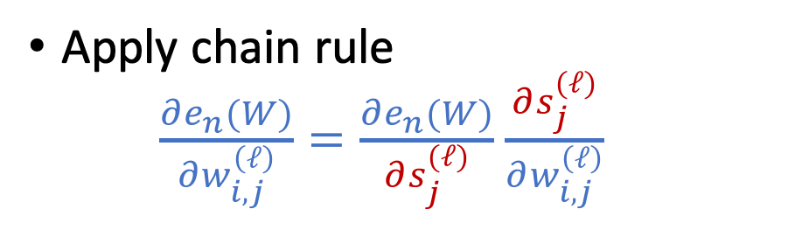

Compute the Gradient $∇_{W}e_{n}(W)$
To evaluate $∇_{W}e_{n}(W)$, we need to calculate $\frac{∂e_{n}(W)}{∂w_{i,j}^{\left(ℓ\right)}}$for all $(i,j,ℓ)$
Zoom in on the region around $w_{i,j}^{(ℓ)}$
Apply chain rule $\frac{∂e_{n}(W)}{∂w_{i,j}^{\left(ℓ\right)}}=\frac{∂e_{n}(W)}{∂s_{j}^{(ℓ)}}$ $\frac{∂s_{j}^{(ℓ)}}{∂w_{i,j}^{\left(ℓ\right)}}$

Slide 28
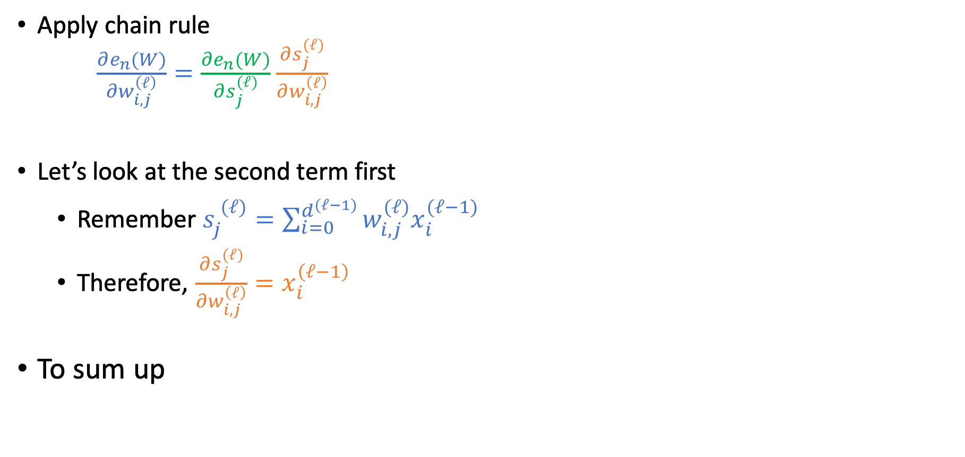
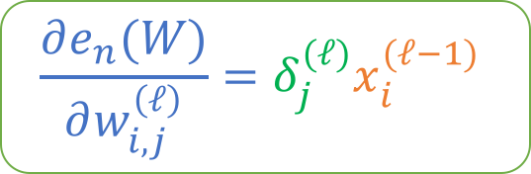
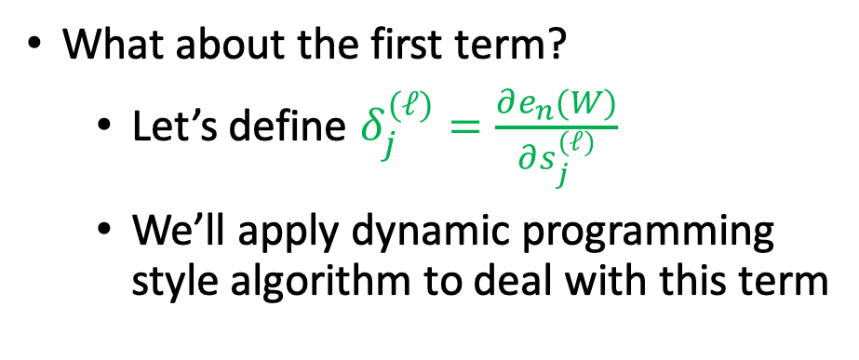
Compute the Gradient $∇_{W}e_{n}(W)$
Apply chain rule $\frac{∂e_{n}(W)}{∂w_{i,j}^{\left(ℓ\right)}}=\frac{∂e_{n}(W)}{∂s_{j}^{(ℓ)}}$ $\frac{∂s_{j}^{(ℓ)}}{∂w_{i,j}^{\left(ℓ\right)}}$
Let’s look at the second term first
Remember $s_{j}^{ (ℓ)}=\sum_{i=0}^{d^{(ℓ−1)}}{w_{i,j}^{(ℓ)}x_{i}^{(ℓ−1)}}$
Therefore, $\frac{∂s_{j}^{(ℓ)}}{∂w_{i,j}^{\left(ℓ\right)}}=x_{i}^{\left(ℓ−1\right)}$
To sum up
What about the first term?
Let’s define $δ_{j}^{(ℓ)}=\frac{∂e_{n}(W)}{∂s_{j}^{(ℓ)}}$
We’ll apply dynamic programming style algorithm to deal with this term
$$\frac{∂e_{n}(W)}{∂w_{i,j}^{\left(ℓ\right)}}=δ_{j}^{(ℓ)}x_{i}^{(ℓ−1)}$$

Slide 29
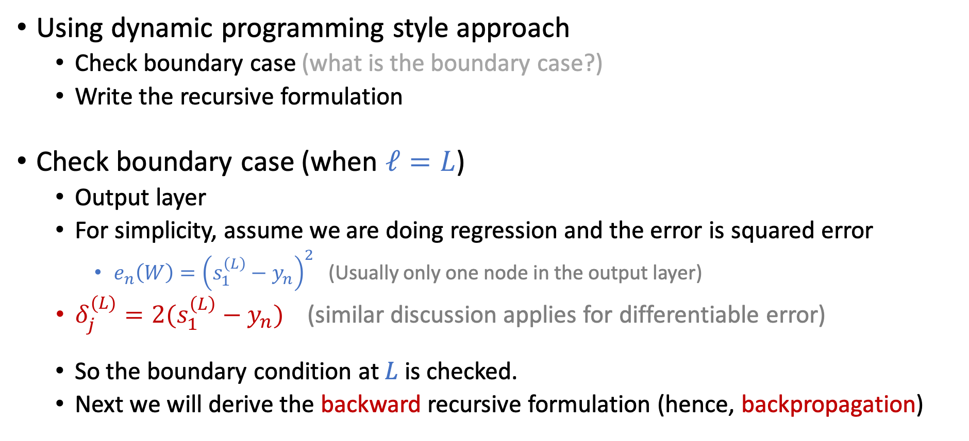

Compute $δ_{j}^{(ℓ)}=\frac{∂e_{n}(W)}{∂s_{j}^{(ℓ)}}$
Using dynamic programming style approach
Check boundary case (what is the boundary case?)
Write the recursive formulation
Check boundary case (when $ℓ=L$)
Output layer
For simplicity, assume we are doing regression and the error is squared error
$e_{n}\left(W\right)={\left(s_{1}^{\left(L\right)}−y_{n}\right)}^{2}$ (Usually only one node in the output layer)
$δ_{j}^{(L)}=2(s_{1}^{\left(L\right)}−y_{n})$ (similar discussion applies for differentiable error)
So the boundary condition at $L$is checked.
Next we will derive the backward recursive formulation (hence, backpropagation)

Slide 30
Compute $δ_{j}^{(ℓ)}=\frac{∂e_{n}(W)}{∂s_{j}^{(ℓ)}}$
Zoom in to see the chain of dependencies

Slide 31

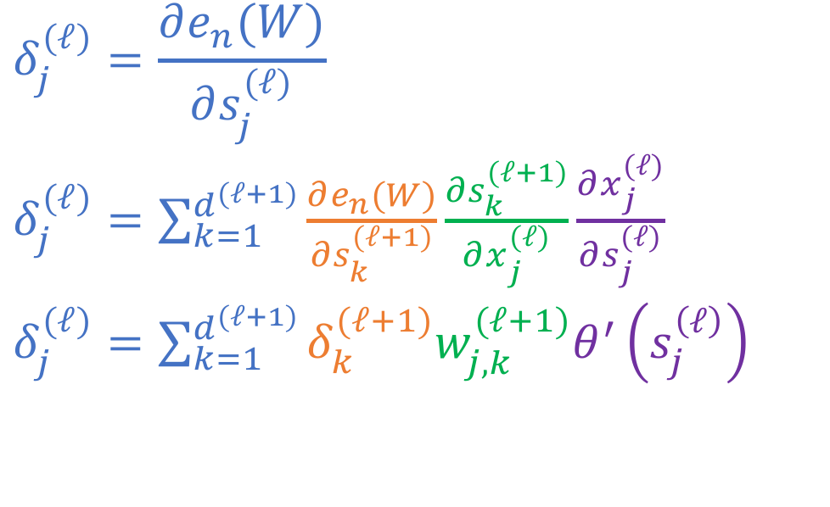
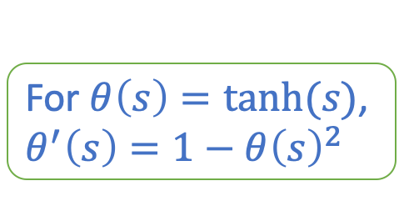
Compute $δ_{j}^{(ℓ)}=\frac{∂e_{n}(W)}{∂s_{j}^{(ℓ)}}$
Zoom in to see the chain of dependencies
For $θ\left(s\right)=tanh⁡(s)$, $θ^{′}\left(s\right)=1−θ{\left(s\right)}^{2}$
$$δ_{j}^{(ℓ)}=\frac{∂e_{n}(W)}{∂s_{j}^{(ℓ)}}$$
$δ_{j}^{(ℓ)}=\sum_{k=1}^{d^{(ℓ+1)}}{\frac{∂e_{n}(W)}{∂s_{k}^{(ℓ+1)}}\frac{∂s_{k}^{(ℓ+1)}}{∂x_{j}^{(ℓ)}}\frac{∂x_{j}^{(ℓ)}}{∂s_{j}^{(ℓ)}}}$
$δ_{j}^{(ℓ)}=\sum_{k=1}^{d^{(ℓ+1)}}{δ_{k}^{(ℓ+1)}w_{j,k}^{(ℓ+1)}θ^{′}\left(s_{j}^{\left(ℓ\right)}\right)}$
We have the backward recurve definition!

Slide 32
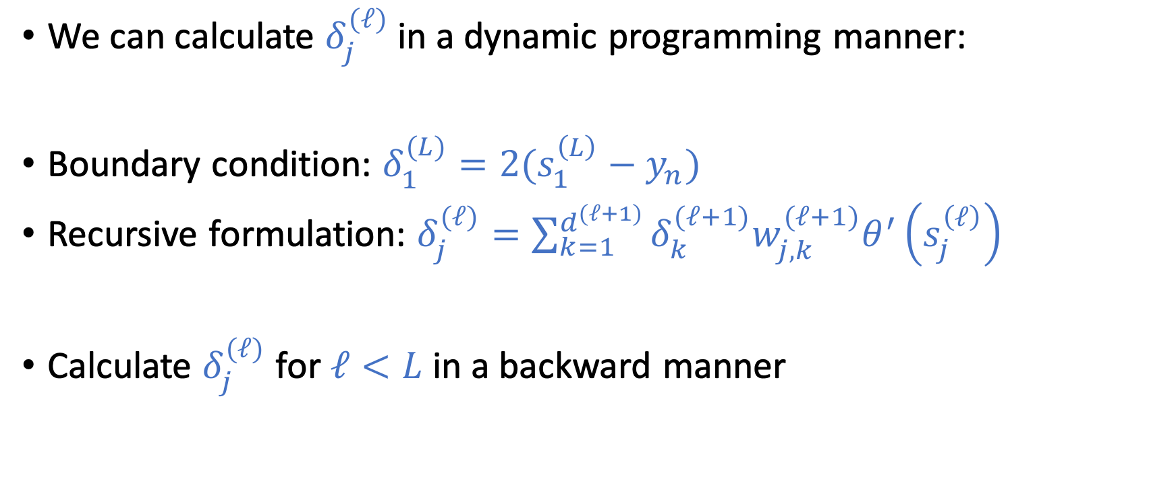
Compute $δ_{j}^{(ℓ)}=\frac{∂e_{n}(W)}{∂s_{j}^{(ℓ)}}$
We can calculate $δ_{j}^{(ℓ)}$ in a dynamic programming manner:
Boundary condition: $δ_{1}^{(L)}=2(s_{1}^{\left(L\right)}−y_{n})$
Recursive formulation: $δ_{j}^{(ℓ)}=\sum_{k=1}^{d^{(ℓ+1)}}{δ_{k}^{(ℓ+1)}w_{j,k}^{(ℓ+1)}θ^{′}\left(s_{j}^{\left(ℓ\right)}\right)}$
Calculate $δ_{j}^{(ℓ)}$ for $ℓ<L$ in a backward manner

Slide 33
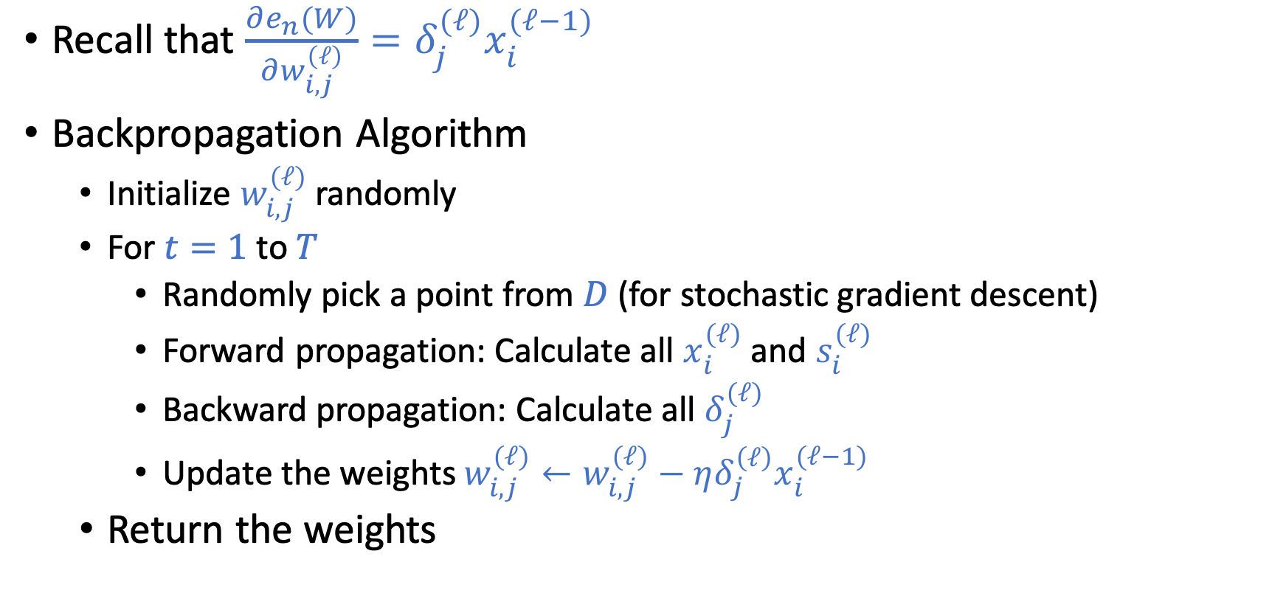
Backprogagation Algorithm
Recall that $\frac{∂e_{n}(W)}{∂w_{i,j}^{\left(ℓ\right)}}=δ_{j}^{(ℓ)}x_{i}^{(ℓ−1)}$
Backpropagation Algorithm
Initialize $w_{i,j}^{(ℓ)}$randomly
For $t=1$ to $T$
Randomly pick a point from $D$ (for stochastic gradient descent)
Forward propagation: Calculate all $x_{i}^{(ℓ)}$ and $s_{i}^{(ℓ)}$
Backward propagation: Calculate all $δ_{j}^{(ℓ)}$
Update the weights $w_{i,j}^{(ℓ)}←w_{i,j}^{(ℓ)}−ηδ_{j}^{\left(ℓ\right)}x_{i}^{(ℓ−1)}$
Return the weights

Slide 34
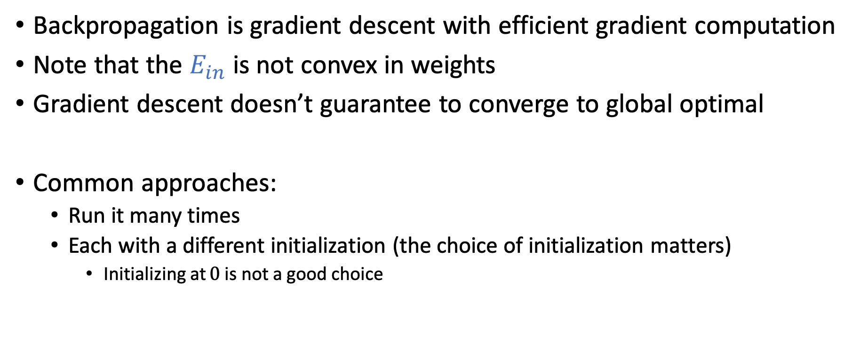
Discussion
Backpropagation is gradient descent with efficient gradient computation
Note that the $E_{in}$ is not convex in weights
Gradient descent doesn’t guarantee to converge to global optimal
Common approaches:
Run it many times
Each with a different initialization (the choice of initialization matters)
Initializing at $0$ is not a good choice

Slide 35
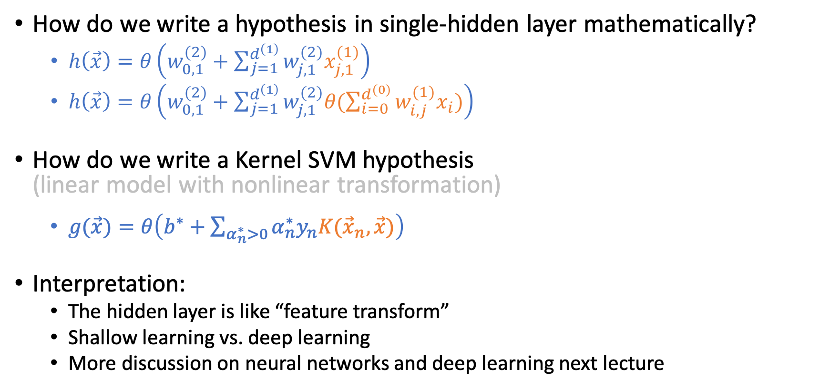
Single Hidden-Layer Neural Network
How do we write a hypothesis in single-hidden layer mathematically?
$h\left(\vec{x}\right)=θ\left(w_{0,1}^{\left(2\right)}+\sum_{j=1}^{d^{\left(1\right)}}{w_{j,1}^{\left(2\right)}x_{j,1}^{\left(1\right)}}\right)$
$h\left(\vec{x}\right)=θ\left(w_{0,1}^{\left(2\right)}+\sum_{j=1}^{d^{\left(1\right)}}{w_{j,1}^{\left(2\right)}θ(\sum_{i=0}^{d^{(0)}}{w_{i,j}^{(1)}x_{i}})}\right)$
How do we write a Kernel SVM hypothesis (linear model with nonlinear transformation)
$g(\vec{x})=θ\left(b^{∗}+\sum_{α_{n}^{∗}>0}{α_{n}^{∗}y_{n}K({\vec{x}}_{n},\vec{x})}\right)$
Interpretation:
The hidden layer is like “feature transform”
Shallow learning vs. deep learning
More discussion on neural networks and deep learning next lecture

